Slide 1
ART as prevention: PEP & PrEP
Dr Laura Waters
HIV/GU Medicine
Brighton & Sussex University NHS Trust

Slide 2
Introduction
HIV prevention overview
Using ART
  In HIV negative
    Pre-exposure prophylaxis (PrEP)
    Post-exposure prophylaxis (PEP)
  In HIV positive
    Treatment as prevention

Slide 3
Prevention is the Foundation
For Treatment Sustainability
GLOBALLY
6 new infections for every
person started on therapy!
Notes:
The management of HIV infection has dramatically changed since the epidemic first began in the early 80s. We now have effective treatment available in order to manage HIV infection but unfortunately not yet a cure. Whilst treatment is effective, no major barrier remains the provision of treatment to those who need it. In 2006 there were 700,000 people started on antiretroviral therapy drugs. This was only providied to 28% of those who needed it. With over 4 millions new infections in 2006 this equates to 6 new infections for every person started on treatment. Prevention therefore is a major factor in Hglobal IV management

Slide 4
Prevention Methods
HIV Prevention
Behavioural
Structural
Biomedical

Slide 5
Determinants of risky sexual behaviour
  Individual factors
    Low self-esteem, lack of skills, lack of knowledge
  External influences
    Peer pressure/attitudes & prejudices of society
  Service provision
    Accessibility of sexual health services, resources (condoms)
www.nice.org.uk/PHI003
Notes:
11/11 meta-analyses: significant effect on condom use
9/11 (82%): significant effect on unprotected sex
3/8 (38%): significant effect on number of sexual partners
4/6 (67%): significant effect on STI acquisition

Slide 6
Further Reading
Noar SM. Behavioural interventions to reduce HIV-related sexual risk behaviour: review and synthesis of meta-analytic evidence. AIDS Behav 2008; 12:335-353.

Slide 7
Structural
Testing programmes & earlier diagnosis
Needle Exchanges
Condom Provision
STI control
Targeted outreach services
Targeted education
Tackling Legal barriers
Tackling Stigma

Slide 8
Biomedical
Circumcision
  57% reduction in acquisition (RCT)
  43% less transmission to females (cohort)
Microbicides
  Many failures
  Only ART containing have shown good efficacy
ARV therapy
  Treatment as Prevention
  PEP
  PrEP
Vaccines
  The holy grail
  Many failures
  Moderate effect at best

Slide 9
Biomedical
Circumcision
  57% reduction in acquisition (RCT)
  43% less transmission to females (cohort)
Microbicides
  Many failures
  Only ART containing have shown good efficacy
ARV therapy
  Treatment as Prevention
  PEP
  PrEP
Vaccines
  The holy grail
  Many failures
  Moderate effect at best

Slide 10
Post-exposure prophylaxis (PEP)
Occupational
  Needle stick injury (NSI)
  Mucosal exposure
Non-occupational
  Sexual exposure (PEPSE)
  Sexual assault

Slide 11
Significant exposure
Percutaneous injury, contact of mucous membrane or non-intact skin, with:
  Blood, tissue or other bodily fluids
Bodily fluids:
  Semen, vaginal secretions
  Any blood stained fluid (CSF, synovial, amniotic, pleural, peritoneal, pericardial fluids)
  Saliva (only in association with dentistry)
  Unfixed tissues and organs

Slide 12
Risk of HIV acquisition from NSI
Notes:
There is a significant risk of HIV infection from a needlestick injury but this is significantly lower from the risk of the other blood borne viruses. Approxiomately 1 in 300 people who have a needlestick injjury from an HIV positive person will acquire HIV from this.
Compare this to hepatitis B where one third (30%) of people will become infected with hepatitis B and 3% or 3 in 100 will become infected with hepatitis C if the needlestick was from someone who has active hepatitis C infection

Slide 13
Estimated global infections from NSI
70,000-150,000

Slide 14
Relative Risk of HIV Infection After NSI
RISK FACTORS | ADJUSTED ODDS RATIO | 95% CI
Deep injury | 16.1 | 6.1-44.6
Visible blood on device | 5.2 | 1.8-17.7
Needle placed directly in artery or vein | 5.1 | 1.9-14.8
Terminal illness in source patient | 6.4 | 2.2-18.9
Post exposure use of AZT | 0.2 | 0.1-0.6

Slide 15
Management
First aid
Decide if PEP appropriate
  Significant exposure to definite/very probable HIV
  Appropriate timing (ASAP, <72 hours)
Test source
  UNIVERSAL approach (local guidelines) reduces
    Difficult decisions
    Perceived discrimination

Slide 16
Sexual exposure: estimated risks
TYPE OF EXPOSURE | ESTIMATED MEDIAN (RANGE) RISK PER EXPOSURE
Receptive anal intercourse | 1.11% (0.042-3.0%)
Insertive anal intercourse | 0.06% (0.06-0.065%)
Receptive vaginal intercourse | 0.1% (0.04-0.32%)
Insertive vaginal intercourse | 0.082% (0.011-0.38%)
Receptive oral sex (fellatio) | 0.02% (0-0.04%)
Insertive oral sex (receiving fellatio) | 0%
Blood transfusion (1 unit) | (90-100%)
Needle stick injury | 0.3% (0.2-0.5%)
Sharing injecting equipment | 0.67%
Mucous membrane exposure | 0.63% (0.018-3.37%)
Source: UK PEP Guidelines 2011

Slide 17
Estimated per-episode UPAI risk of HIV transmission [Jin et al. AIDS 2010]
 | PER CONTACT PROBABLITY | 95% CI
INSERTIVE AI
Uncircumcised | 0.62 | 0.07-1.68
Circumcised | 0.11 | 0.02-0.24
RECEPTIVE AI
Withdrawal | 0.65 | 0.15-1.53
Ejaculation | 1.43 | 0.48-2.85
1427 HIV -ve MSM community cohort 2001-2007
F/U 4537 person years (median 3.9 years)
High uptake of HIV testing and ART

Slide 18
Other factors
Viral load of source
Other sexually transmitted infections

Slide 19
UK PEP recommendations 2011
SOURCE HIV STATUS
 | HIV+, VL+ | HIV+, VL <50 | ?, HIGH PREV GROUP/AREA | ?, LOW PREV GROUP/AREA
RAI
IAI
RVI
IVI
Fellatio with ejaculation
Fellatio without ejaculation
Splash of semen in eye
Cunnilingus
Sharing injecting gear
Human bite
NSI (discarded needle)

Slide 20
PEP: Common principles
WHEN
  Ideally as soon as possible (2-4 hours)
  Not >72 hours
  Do not delay while awaiting results
WHAT
  3 active drugs
HOW LONG
  4 weeks
  Stop if source tests HIV-

Slide 21


Drugs NOT recommended
Nevirapine
  High risk hepatitis
Abacavir
  High risk hypersensitivity

Slide 22
PEP: What IS recommended
US guidelines:
  any combination based on local use
UK guidelines:
  1st line: Truvada + Kaletra
  2nd line NRTI: AZT OR d4T + 3TC or FTC
  2nd line 3rd drug: DRV/r or ATV/r (or RAL)
  3 NRTI may be given alone (d4T + Truvada)
Notes:
The standard PEP regimen includes the used of 2 nucleoside analogues either azt, d4t or tenofovir in combination with 3tc or ftc. This is usually given with a protease inhibitor such as nelfinavir or kaletra
In some resource poor settings nucleosides are given alone.

Slide 23
Support
Prescribe anti-emetics and anti-diarrhoeals depending on regimen
Give psychological support
Follow-up as appropriate
  Hepatitis B/C
  Risk reduction
  HIV testing

Slide 24
Tests
HIV
  A baseline HIV test
  Follow-up 3 months after completing PEP
HBV: vaccinate if uncertain
HCV: consider HCV-RNA if high risk source
Safety
  Baseline
  2 weekly
Pregnancy test

Slide 25
Other issues
Drug interactions
Pregnancy
Confidentiality
Sexual activity/blood donation/occupation
AVAILABILITY
  Staff for PEP advice and follow-up
  PEP packs in accessible and well-advertised sites
  Starter packs of 3-5 days of PEP to cover weekends

Slide 26
PEP: What’s the evidence?

Slide 27
Rationale - Animal Models
SIV/Macaque iv innoculation tenofovir - both Timing & Duration important [Tsai et al]
Tenofovir effective 36hrs post vaginal innoculation [Otten et al]
Subbarao - Repeated rectal innoculation - delay only J Infect Dis 194: 904–911 2006
Heineine - complete protection with injectable tenofovir Garcia-Lerma et al PLoS Medicine February 2008 | Volume 5 Issue 2 | e28

Slide 28
Protection from SIV infection following multiple rectal exposures in macaques using TDF,FTC or both
100
Injectable FTC/Tenofovir (n = 6)
75
Oral truvada (n = 6); p = 0.0004 [HR = 7.8]
50
% Uninfected animals
Injectable FTC (n = 6); p = 0.005 [HR = 3.9]
25
Oral TDF (n = 4); p = 0.095
Controls (n = 18)
0
0
2
4
6
8
10
12
14
Number of rectal exposures
Garcia-Lerma et al PLoS Medicine February 2008 | Volume 5 Issue 2 | e28

Slide 29
Both Timing and Duration of Chemoprophylaxis Important
Duration of Rx Protected
3 days 0
10 days 50%
4 weeks All
Timing (Initiation of Rx)
< 24 hours All
> 48 hours 50%
> 72 hours 25%
SIV/Macaque model – PEP/PMPA
Tsai 1998, J. Virol 72 4265-73

Slide 30
Evidence: HCW case control study
Cardo DM et al. N. Engl. J Med 1997; 337:1485
Notes:
The evidence in humans is a retrospective case controlled study among health care workers showing a protective effect of a 4 week course of AZT
OR 0.19 (CI 0.06-0.52%)
These other factors affecting risk are the results from a case controlled study of AZT monotherapy in health care workers
Exposure characteristics such as depth and site of injury are important
Clearly the size of innoculum is important (visible blood a greater volume, and AIDS reflecting a high VL
AZT monotherapy protective OR 0.2

Slide 31
PEP(SE): other evidence
MTCT:
  Further reduction in transmission with infant PEP
Animal model studies:
  Protection with PEP (anal and vaginal)
  Increased with: early initiation; longer duration
Observational studies

Slide 32
PEPSE Studies
San Francisco
n=401
94% sexual risk (40% anoreceptive)
Median time to PEP = 33hrs
Dual therapy (usually combivir)
At 6 months NO SEROCONVERSIONS (CI 0-4)
Khan et al. JID 2001;183:707-714.

Slide 33
Seroconversion after PEPSE
N=700 given dual NRTI PEP within 72 hrs
Seroconvertors (7) vs non seroconvertors:
  More likely RAI: 100% vs 50% (p= 0.03)
  Trend to later treatment: 46 vs 33 hrs (p=0.11)
  Poor adherence in 3/7
  No molecular epidemiology
Roland et al. CID 2005;41:1507-1513

Slide 34
Sao Paulo PEP Study
Sexual Assault
  <72hrs : given PEP
  >72hrs: no PEP given (control group)
Seroconversions:
  0/182 in PEP group
  4/145 (2.7%) in control group
  p=0.037
Drezett et al. 2000

Slide 35
PEPSE ineffective in MSM:
Praca Onze Study
200 MSM in Rio, Brazil; 24 months follow-up
Given PEP pack to start after risk exposure
Seroconversions
  10 in “non-PEP users” (4.2%)
  1 seroconversion in “PEP user” (0.6%); p<0.05
BUT overall HIV incidence
  2.9/100PY vs to 3.1/100PY expected; p>0.97
Schechter M et al; JAIDS, 2004

Slide 36
PEPSE ineffective in MSM:
Praca Onze Study
Reasons for not starting PEP
  Not considered high risk practice
  Sex with steady partner
  Worried about side effects (AZT)
Behaviour survey:
  No evidence of increased risk behaviour
Cost effective & safe
Schechter M et al; JAIDS, 2004

Slide 37
Missed PEP doses:
UK 2011 Guidance
MISSED DOSES | RECOMMENDATION | COMMENTS
<24h since missed dose | Take missed dose immediately and following doses at usual time | Reinforce adherence, review motivation to take PEP
24-72h since missed dose | Re-start PEP | Reinforce adherence and review motivation to take PEP
>72h since missed dose | Stop PEP

Slide 38
PrEP
ART to HIV- prior to exposure
Effective in animal studies
Continuous vs episodic
Even if <100% efficacy has large potential to reduce incidence

Slide 39
Recent Events
FEM-PrEP study stopped for futility
  April 18th, 2011
Partners PrEP placebo arm stopped for efficacy
  July 13th, 2011
CDC announce positive TDF2 results
  July 13th, 2011

Slide 40
A Brief History of ART PrEP
1995
PMPA effective
in macaque
model
2006
HPTN-059
Phase 2
2011
Partners
PrEP
2011
Partners
PrEP
2012
MTN-003
VOICE
2010
iPrEX
2011
FEM-PrEP
2011
TDF2
2011
FACTS-001
TDF gel to
confirm 004
in diverse
population
2005
HPTN-050
Phase 1 PMPA
PV gel (PK &
Safety)
2007
TDF
PrEP
Study
2010
CAPRISA 004
Phase 2B
2011
HPTN-052
Adapted from McGowan; IAS 2011.
Notes:
40
40

Slide 41
Studies to date
What has worked
What hasn’t worked
Oral TDF/FTC in MSM
  iPrEx
Oral TDF/FTC in heterosexuals in Africa
  TDF2
  Partners PrEP Study
Oral TDF in heterosexuals in Africa
  Partners PrEP Study
TDF gel in women in Africa
  CAPRISA 004
Oral TDF in women in Africa
  VOICE stopped early
Oral TDF/FTC in women in Africa
  FEMPREP stopped early
What is working so far
TDF gel in women in Africa
  VOICE

Slide 42



The iPrEx Study
MSM and Trans Women
Comprehensive Prevention Package
Randomized 1:1 Daily Oral PREP
FTC/TDF vs Placebo
Followed Monthly on Drug

Slide 43


Fully enrolled as of December 2009
Sites | 11
Participants | 2499
San Francisco
Boston
Chiang Mai
Iquitos
Guayaquil
Sao Paulo
Lima
Rio de Janeiro
Cape Town
New England Journal of Medicine, online Nov 23, 2010

Slide 44
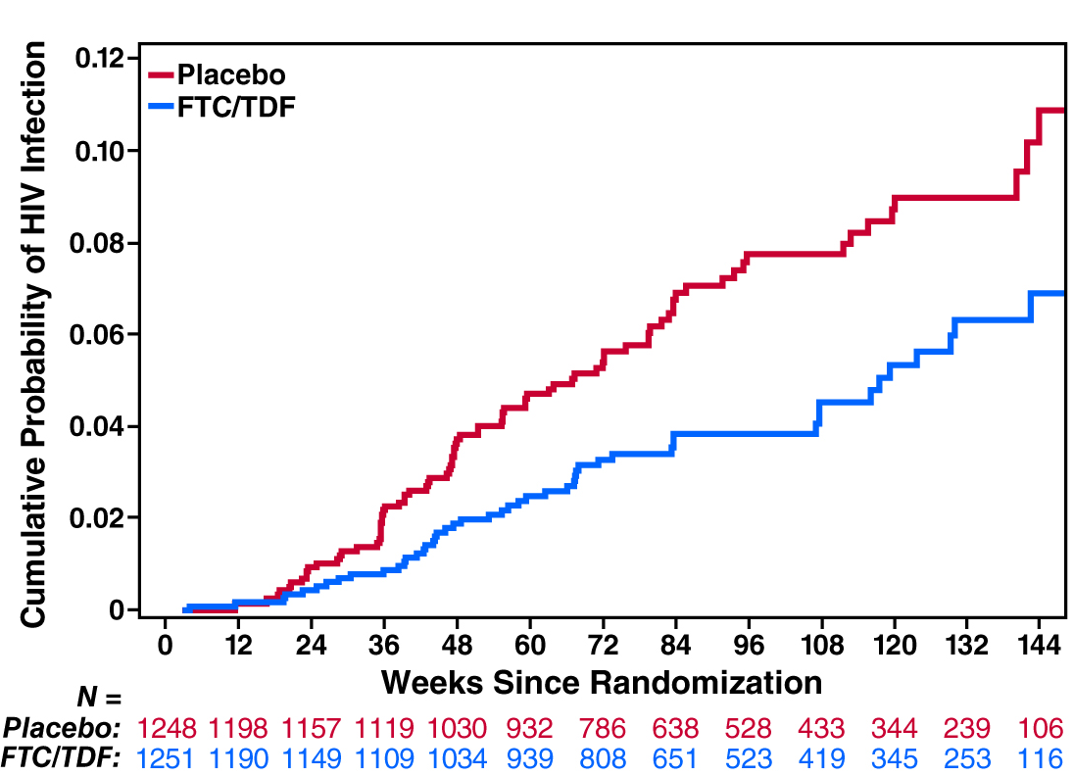
Efficacy (MITT) 44% (15-63%) Durable Through 144 Weeks (Final Analysis)
P = 0.002
Grant et al, CROI 2011
Notes:
eso es nuevo

Slide 45
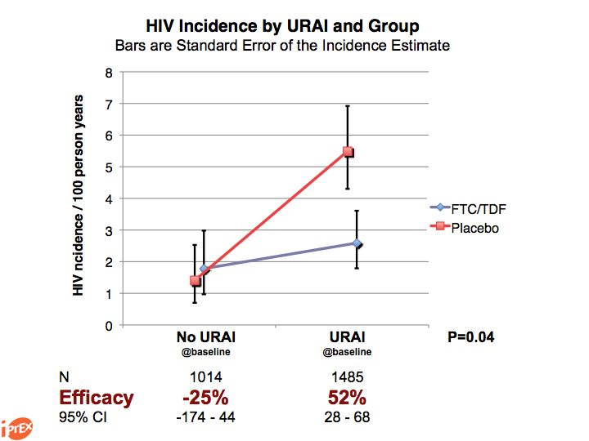
Grant et al, CROI 2011

Slide 46
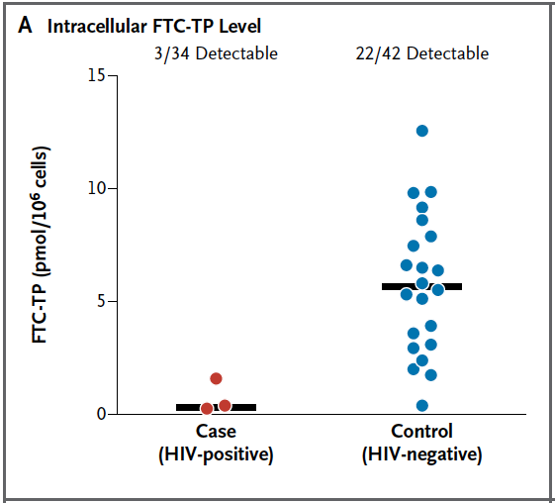
Drug levels
Drug Levels
Cases matched to controls by site and time on study
Drug detection Correlated with Seronegative Status (OR 12.9, P<0.001)
  92% reduction in HIV risk
  95% if controlled for Unprotected RAI
New England Journal of Medicine, online Nov 23, 2010
Notes:
As noted before, the proportion of HIV infected persons who had any detectable drug was low (9%).
Among HIV infected persons with detectable drug, the levels inside cells were low. The half life of FTC-TP inside cells in 39 hours, and the half life of TFV-DP inside cells is approximately 150 hours.
The high plasma drug level in one person came with a very low level in cells. This pattern can be seen when people have taken pills right before the clinic visit.

Slide 47
FEMPREP
Study of oral Truvada in HIV-negative women in Kenya, Tanzania & South Africa
Terminated early (2000 of planned 4000 recruited)
  28 new HIV infections in each arm

Slide 48
FEMPREP
Study of oral Truvada in HIV-negative women in Kenya, Tanzania & South Africa
Terminated early (2000 of planned 4000 recruited)
  28 new HIV infections in each arm
CDC has cautioned women AGAINST using PrEP

Slide 49
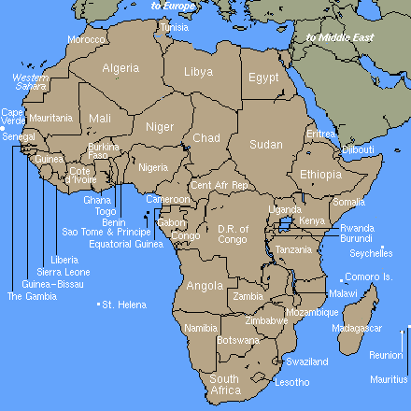

Partners PrEP Study: Sites
Eldoret,
Kisumu,
Nairobi,
Thika,
Kenya
Jinja,
Kabwohe,
Kampala,
Mbale,
Tororo,
Uganda

Slide 50
Partners PrEP Study
4758 HIV serodiscordant couples
(HIV+ partner not yet medically eligible for ART)
Randomize HIV- partners
(normal liver, renal, hematologic function)
TDF once daily
FTC/TDF once daily
Placebo once daily
All receiving comprehensive HIV prevention services
Follow monthly for up to 36 months
1° endpoint: HIV infection in HIV- partner
Co- 1° endpoint: Safety
Notes:
50

Slide 51
Population characteristics
 | Total (n=4747*) | TDF (n=1584) | FTC/TDF (n=1579) | Placebo (n=1584)
HIV- partner female / male | 38% / 62% | 38% / 62% | 36% / 64% | 39% / 61%
Age of HIV- partner, years (median/IQR) | 33 (28,40) | 33 (28,40) | 33 (28,40) | 33 (28,40)
Couple married | 98% | 97% | 98% | 98%
Duration of partnership, years (median/IQR) | 7 (3,14) | 7 (3,14) | 7 (3,14) | 7 (3,14)
Duration known HIV serodiscordant, years (median/IQR) | 0.4 (0.1,2.0) | 0.5 (0.1,2.0) | 0.4 (0.1,2.0) | 0.4 (0.1,2.0)
CD4 count, HIV+ partner, cells/mm³ (median/IQR) | 495 (375,662) | 491 (370,661) | 497 (380,664) | 499 (375,663)
Plasma viral load, HIV+ partner, log₁₀ copies/mL (median/IQR) | 3.9 (3.2, 4.5) | 3.9 (3.2,4.5) | 3.9 (3.1,4.5) | 3.9 (3.2,4.5)
Started ART, HIV+ partner, during follow-up | 19% | 20% | 18% | 20%
* 11 couples found after randomization to be ineligible and exited from the study

Slide 52
Retention and Adherence
Retention: 94-100% across the monthly visits
Study month (# expected) | Total | TDF | FTC/TDF | Placebo
Month 6 (n=4738) | 98% | 98% | 98% | 98%
Month 24 (n=2027) | 95% | 94% | 95% | 95%
Person-years of follow-up | 7,337 | 2,441 | 2,452 | 2,444
Adherence: calculated from returned unused drug
 | Total | TDF | FTC/TDF | Placebo
Dispensed doses taken | 97% | 97% | 97% | 97%
Pill bottles returned | 98% | 98% | 98% | 98%

Slide 53
Primary efficacy results
Primary analysis: modified intention-to-treat (mITT)
  excluding infections present at randomization (3 TDF, 3 FTC/TDF, 6 placebo)
 | TDF | FTC/TDF | Placebo
Number of HIV infections | 18 | 13 | 47
HIV incidence, per 100 person-years | 0.74 | 0.53 | 1.92
HIV protection efficacy, vs placebo | 62% | 73%
95% CI | (34-78%) | (49-85%)
p-value | 0.0003 | <0.0001
Z-score, vs. H₀=0.7 | -2.17 | -2.99
Effect of TDF and FTC/TDF
statistically similar (p=0.18)
ITT analysis results similar

Slide 54
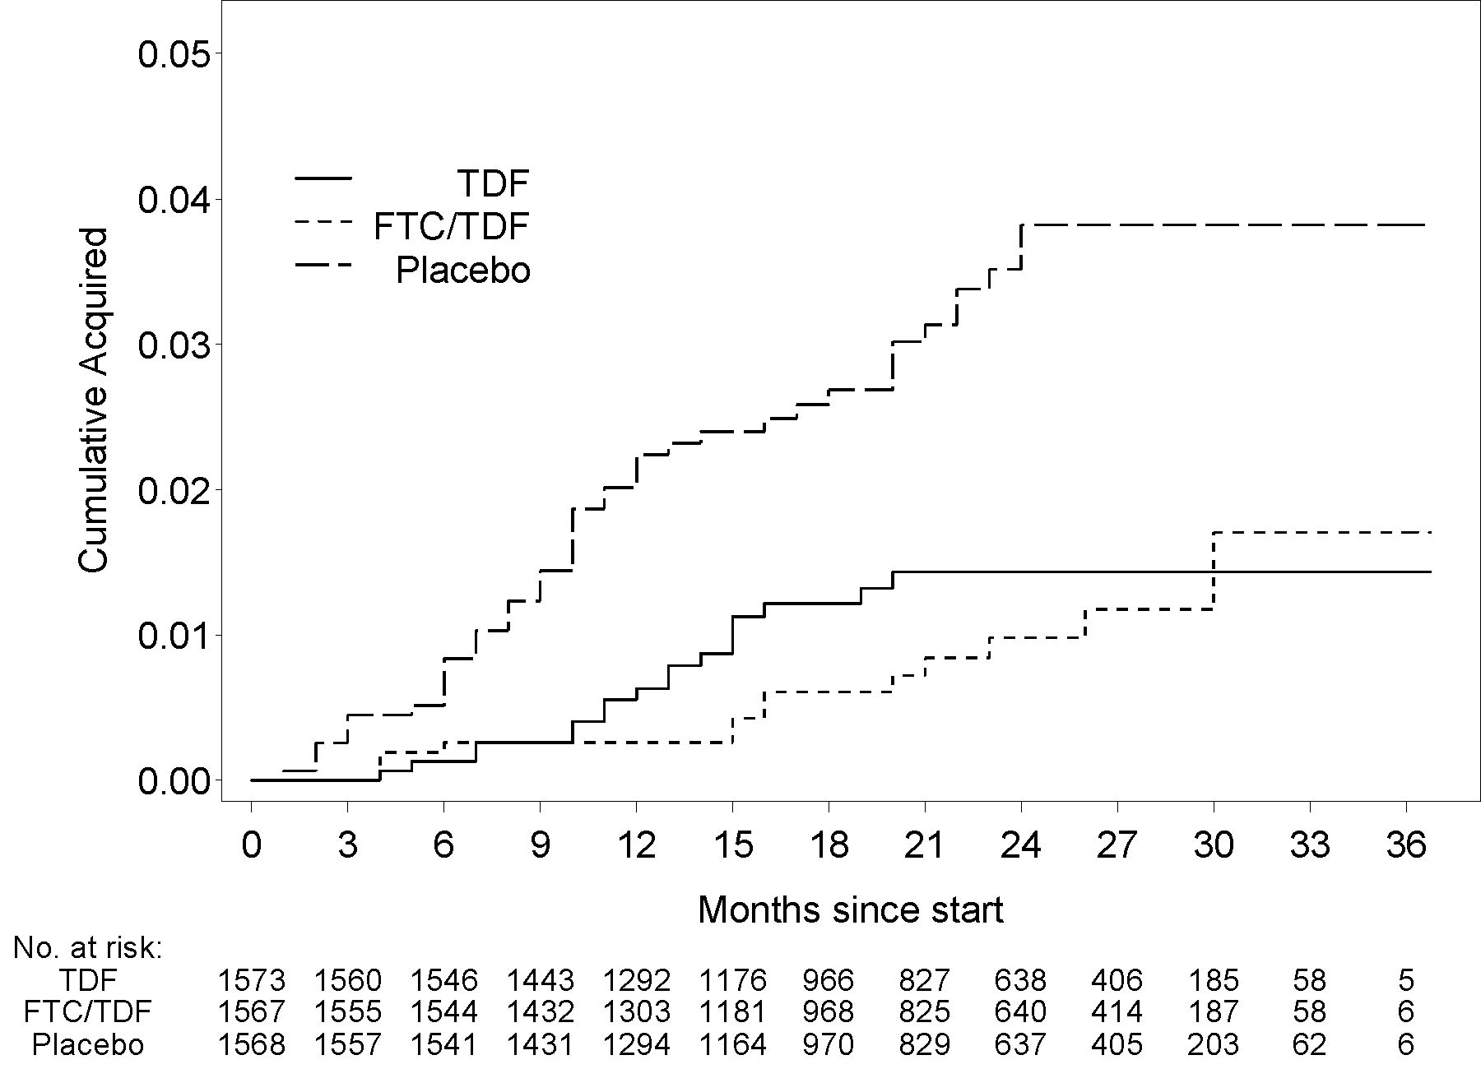
Primary efficacy results
TDF
FTC/TDF
Placebo

Slide 55
Primary efficacy results
Placebo arm terminated
TDF
FTC/TDF
Placebo

Slide 56
Subgroup analysis - gender
Both TDF and FTC/TDF significantly reduced HIV risk in both men and women
Women: 42 total infections: 8 TDF, 9 FTC/TDF, 25 placebo
Men: 36 infections: 10 TDF, 4 FTC/TDF, 22 placebo
 | Efficacy | 95% CI | P-value | Interaction p-value
TDF
Women Men | 68% 55% | 29-85% 4-79% | p=0.01 p=0.04 | p=0.54
FTC/TDF
Women Men | 62% 83% | 19-82% 49-94% | p=0.01 p=0.001 | p=0.24

Slide 57
Daily oral antiretroviral use for the prevention of HIV infection in heterosexually active young adults in Botswana: results from the TDF2 study
57
MC Thigpen, PM Kebaabetswe, DK Smith, TM Segolodi, FA Soud, K Chillag, LI Chirwa, M Kasonde,
R Mutanhaurwa, FL Henderson, S Pathak, R Gvetadze,
CE Rose, LA Paxton for the TDF2 Study Team
Notes:
57
57
57

Slide 58
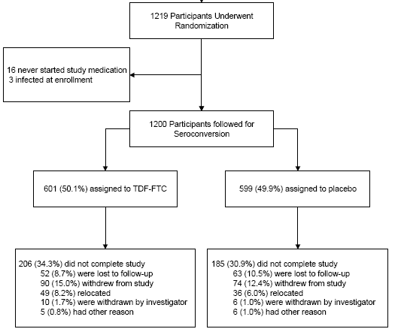
58
Notes:
58
58
58

Slide 59
TDF-2: Efficacy – Intention-to-Treat Analysis
59
9 HIV-infected in TDF-FTC group and 24 HIV-infected in placebo group Overall protective efficacy 62.6% (95% CI 21.5 to 83.4, p=0.0133)
Notes:
59

Slide 60
Efficacy – Participants on Study
4 HIV-infected in TDF-FTC group and 19 HIV-infected in placebo group Overall protective efficacy 77.9% (95% CI 41.2 to 93.6, p=0.0053)
Notes:
60
Medication adherence will be supported by trained counselors
Multiple methods used to measure adherence. Participants will keep a medication diary indicating for each time they take a pil the date and time of day. They will also be queried at different study visits for a self-report about their adherence. Finally, pill counts will be performed at every study visit. We will also conduct random home visits to count pills. Finally after the study is complete, we will test stored blood samples from persons who were taking TDF2 to measure drug levels.

Slide 61
TDF-2: HIV Infection By Gender
Using 33 Seroconverters | TDF-FTC | Placebo | Efficacy | 95% CI | P-value
Female | 7 | 14 | 49.4 | -21.7, 80.8 | 0.107
Male | 2 | 10 | 80.1 | 24.6, 96.9 | 0.026
Using 23 Seroconverters* | TDF-FTC | Placebo | Efficacy | 95% CI | P-value
Female | 3 | 13 | 75.5 | 23.8, 94.4 | 0.021
Male | 1 | 6 | 82.4 | -2.8, 99.1 | 0.065
*ie. Individuals who were adhering to monthly visit schedule
Notes:
61

Slide 62
VOICE – Study Design
Intervention | Daily Truvada or Daily Viread vs. placebo Tenofovir gel vs. placebo
Population | 5,029 sexually active HIV-negative women All participants aged 18-45 years
Locations | South Africa, Zimbabwe, Uganda
Timeline | Study began Sept 2009 Final results anticipated early 2013
Sponsors | MTN, NIH
Amendment to study 09/2011 | TDF arm stopped by DSMB for futility No safety concerns reported with Viread use Truvada and tenofovir gel arms to continue
62

Slide 63
iPrEX vs FEMPREP/VOICE:
Why the difference?
Poor adherence?
  Poor in iPrEX
  Initial reports 95% in FEMPREP
Poor penetration? Rectal > vaginal.
Doesn’t work?
Does work but, by chance, not in this study?
Interaction with hormonal contraception in FEMPREP? More pregnancies in treatment arm
Already HIV+?

Slide 64
Concerns
Side effects
Resistance
Impact on behaviour
Acceptability
  To individuals
    Poor adherence in iPrEX
    Poor recruitment to iPrEX
  To public
  To media

Slide 65
Concerns
€
Side effects
Resistance
Impact on behaviour
Acceptability
  To individuals
    Poor adherence in iPrEX
    Poor recruitment to iPrEX
  To public
  To media

Slide 66
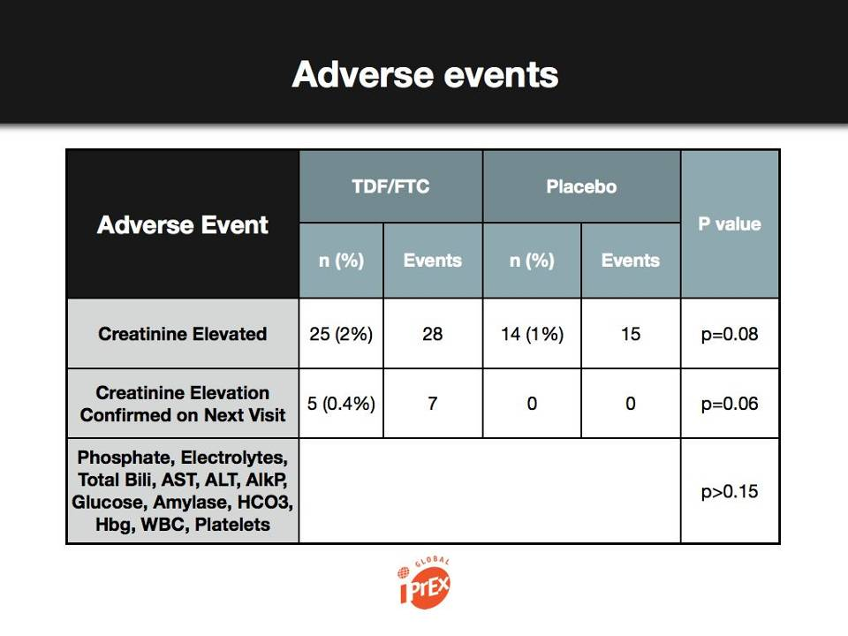
New England Journal of Medicine, online Nov 23, 2010

Slide 67

Safety
No statistically significant difference in deaths, SAEs, key laboratory AEs
Number of participants with each safety event | Total | TDF | FTC/TDF | Placebo
Death | 24 (<1%) | 8 | 7 | 9
SAE | 320 (7%) | 108 | 107 | 105
Confirmed creatinine AE | 49 (1%) | 17 | 20 | 12
Confirmed phosphorus AE | 403 (9%) | 138 | 133 | 132

Slide 68
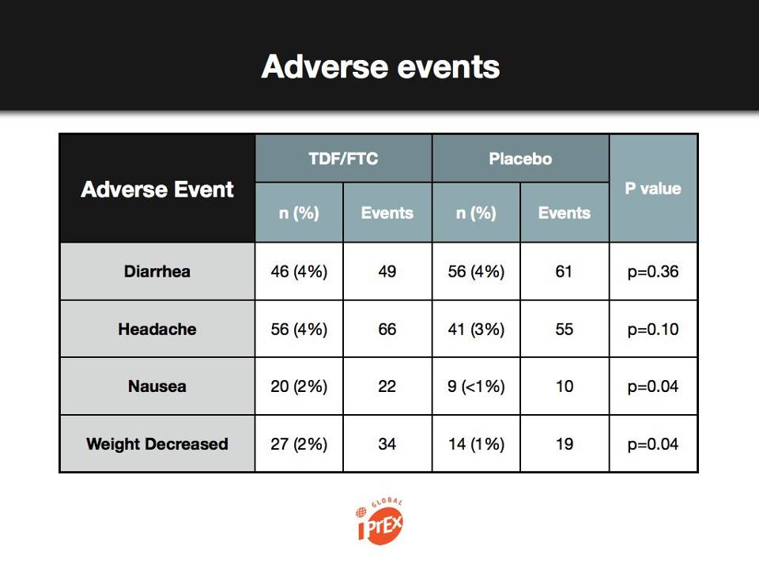
New England Journal of Medicine, online Nov 23, 2010

Slide 69
iPReX: Resistance
New HIV infections (91 samples tested)
  No drug resistance in participants on Truvada
  2 with minor variant drug resistance on placebo
  (1 to tenofovir, 1 to emtricitabine)
HIV infections already present at enrollment
  2 cases of emtricitabine resistance
  Resistance dropped to undetectable levels within 6 months after stopping PrEP (?relevant)

Slide 70
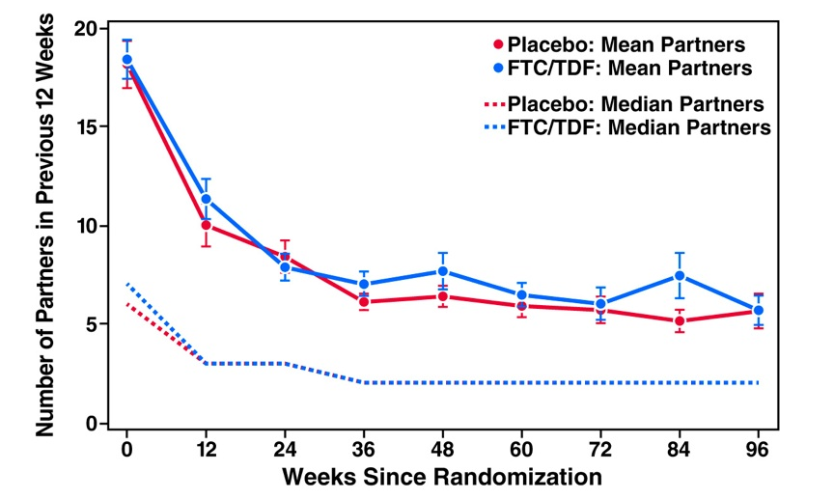

Sexual partners
Sexual Partners
New England Journal of Medicine, online Nov 23, 2010

Slide 71
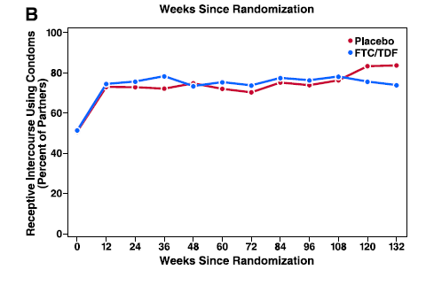
Condom use with high risk sex
Condom Use with High Risk Sex
New England Journal of Medicine, online Nov 23, 2010

Slide 72
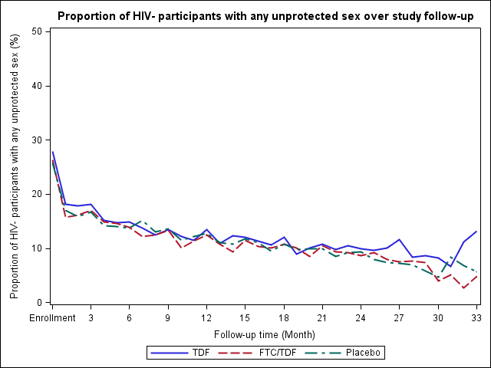
Sexual Behaviour
At enrollment, 27% of couples reported unprotected sex in the past month. This declined during follow-up and was similar across the study arms.
One-third reported an outside partner during the study:
34% TDF, 33% FTC/TDF, 33% placebo

Slide 73
MDP301: Condom use at last sex act with/without Gel by Centre over Time
Notes:
73

Slide 74
Forthcoming PrEP studies
CDC 4370
  Tenofovir daily; IVDUs; due to report 2012
VOICE
  Tenofovir v Truvada (v tenofovir gel)
  Sub-Saharan Africa; women; due 2012

Slide 76
CDC PrEP Interim Guidance 2011
“PrEP has the potential to contribute to effective and safe HIV prevention for MSM if 1) it is targeted to MSM at high risk for HIV acquisition; 2) it is delivered as part of a comprehensive set of prevention services….; 3) it is accompanied by monitoring of HIV status, side effects, adherence, and risk behaviors at regular intervals.”

Slide 77
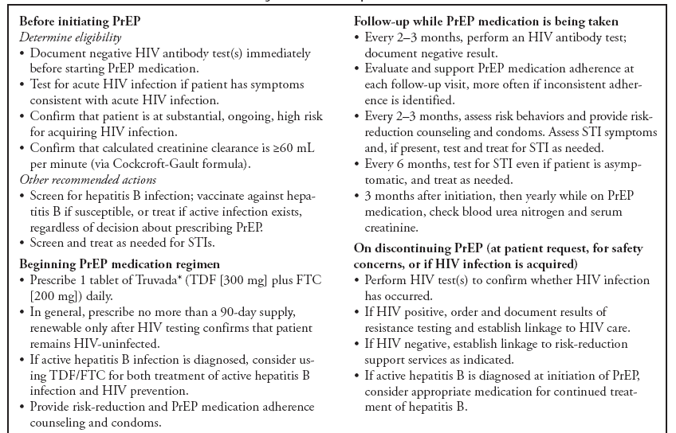
CDC PrEP Interim Guidance 2011

Slide 78
BHIVA / BASHH Position Statement on PrEP in the UK
Fidler S, Fisher M, McCormack S
“It is imperative to gather evidence for the value of PrEP in the UK, in order to achieve universal access should it prove cost-effective as part of a combination prevention package. There are important concerns, and we recommend that ad-hoc prescribing is avoided, and that PrEP is only prescribed in the context of a clinical research study in the UK. Ideally this would be a randomised controlled trial, which is embedded in a broader concerted effort to intensify HIV prevention and implement the existing guidelines”

Slide 79
What about intermittent PrEP?

Slide 80
ANRS Ipergay
ANRS Ipergay Pilot (n~350)
  MSM in France
  Truvada (tenofovir/emtricitabine)
  Double dose (two tablets) before sex
  Single dose a day after sex
Regulatory and ethics approvals in place

Slide 81
PROUD
Pre-exposure Option for preventing HIV in the UK: an open-label randomisation to an immediate or Deferred offer

Slide 82
Aims of PROUD
To offer an alternative to daily PrEP
To determine ‘real-life’ efficacy
  When individuals know PrEP is effective
  Placebo alters behaviour, so need non-placebo control group
Propose randomise to immediate offer vs deferred to 12m
Mimic clinic routine as much as possible
Measure net benefit, i.e. cannot reliably separate behaviour and biology

Slide 83
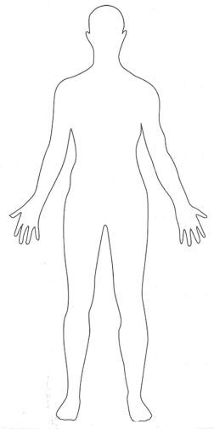
Oral Dosing and Colorectal Tissue
Mucosal Fluid (direct aspirate/sponge)
- Rectal Sponge – MTN 006
Tissue Homogenate or Isolated Cells?
- Rectal tissue TFV 30X BP
MRV 28X BP
ETR, RTV ~10X BP
DRV, FTC ~3X BP
- Rectal tissue IC TFV DP ~ 10²-10³ fmol/mg ^{1,2} FTC TP ~ 10¹ fmol/mg¹
¹Patterson et al IAS 2010, ²Anton et al CROI 2011

Slide 84
PK: TFV-DP in Rectal Tissue
(30 minutes post dose)
7/18
10/12
12/12
Single ORAL: (i) TFV DP Tmax ≥ 24h post-dose. (ii) At 10 days, TFV DP detectable in 55% subjects
Single RECTAL dose: (i) Tissue TFV DP Cmax was 112x > single ORAL and AUC_{all} was 1.5x > single ORAL. (ii) At 10 days, TFV DP detectable in 80%
‘7-day’ RECTAL dosing: Tissue TFV DP accumulated: Cmax was 5x > single RECTAL dose
Notes:
84

Slide 85
Dose-Response Relationship:
rectal tissue TFV DP and rectal biopsy infectibility
Virus inhibition correlated with increasing tissue TFV-DP, even with small study n
Feasible to assess both dose and response following in vivo exposure to drug
Notes:
The single regressor of TVF-DP in tissue was used to predict explant p24. This dose-response relationship was modeled with a linear regression. The r2 shows the proportion of the variance explained by the linear model and the probability value tests whether the slope of the line is significantly different from zero (i.e. horizontal line). We can see that the slope was significant and negative showing virus inhibition with increasing concentrations of TFV-DP. The p24 data were variable and we are looking at dichotomizing the p24 by applying an ‘infected’ vs. ‘non-infected’ criteria so that we can run a probability analyses (logistic regression) to use tissue drug levels to predict infectivity. With this experimental design, we now have the ability to independently vary both the dose and the response to test efficacy after in-vivo exposure to drugs.

Slide 86
Efficacy of oral Truvada regimens against rectal infection
100
-22h/+2h
HR = 16.7, p = 0.006
-3 days/+2h
HR = 15.4, p = 0.008
-7 days/+2h
HR = 9.3, p = 0.003
75
Daily*
HR = 9.9, p = 0.0 02
% Uninfected macaques
+2h/+26h (PEP)
HR = 4, p = 0.03
50
-2h/+22h
HR = 4.1, p = 0.02
25
0
Untreated controls (n=32)
0
2
4
6
8
10
12
14
Number of rectal exposures
Cox proportional hazard model
Garcia-Lerma et al. Science Transl Med 2010
Notes:
86

Slide 87
Rectal and systemic FTC and TFV levels after one oral dose of Truvada (Macaques)
10000
10000
1000
1000
FTC (ng/ml)
TFV (ng/ml)
100
100
10
10
0
2
5
24
0
2
5
24
Time (hours)
Time (hours)
Rectal secretions
Plasma
Walid Heneine, Europrise 3-4May2011

Slide 88
Instructions for Dosing
Take Truvada in the morning if you anticipate that URAI will take place that night
Take another just before going out, or before sex whichever is more convenient
If URAI takes place, take Truvada again (third dose) the morning after the first dose, and the morning after that
If URAI continues, continue Truvada for two mornings after the last URAI
BASED ON HUMAN & ANIMAL PK

Slide 89
Instructions for Missed Doses
If you miss both ‘before sex’ Truvadas, take Truvada as soon as possible after URAI and continue every day
Call the clinic
  Opportunity to assess risk (peri-coital/daily)
  Opportunity to contact partner
What will the clinic do? Discussion
  Add drug to make PEPSE?
  In relation to HIV testing?

Slide 90
Safety Follow-up
Standard SAEs
Medical event that leads clinician to decide no longer safe to prescribe Truvada
Creatinine at enrolment, 12 and 24m with urine dipstick inbetween

Slide 91
Key Challenges for ART PrEP
Increasing adherence in PrEP trials
  Use of objective measures of adherence
Development of PK/PF correlates of protection
Obtaining licensure for tenofovir 1% gel
Life after placebo
Bridging between the end of PrEP effectiveness trials and community availability of PrEP agents
Reducing cost of PrEP delivery

Slide 92
Future Research Priorities
Development / optimization of biomarkers for use in clinical trials
  Sexual exposure
  Adherence
  Safety
  Efficacy
Phase 2/2B development of rectal microbicides
  MTN-017

Slide 93
Future Research Priorities
Evaluation of extended release PrEP agents
  Dapivirine intravaginal ring
  TMC-278
Combination HIV prevention strategies
  T4P + PrEP + circumcision
  PrEP + HIV vaccination
  PrEP + contraceptive products
Moving to implementation

Slide 94
Prevention Trials
Study
Effect size (95% CI)
Treatment for prevention
(Africa, Asia, America’s)
96% (73; 99)
Tenofovir/truvada for discordant couples
(Partners PrEP)
73% (49; 85)
Truvada oral for heterosexuals
(Botswana TDF2)
63% (22; 83)
Medical male circumcision
(Orange Farm, Rakai, Kisumu)
54% (38; 66)
Truvada oral MSMs
(America’s, Thailand, SA)
44% (15; 63)
Tenofovir vaginal
(SA)
39% (6; 60)
HIV Vaccine
(Thailand)
31% (1; 51)
Truvada for women
(Kenya, SA, Tanzania)
0% (-69; 41)
Efficacy
0% 10 20 30 40 50 60 70 80 90 100%
Modified from Slim Karim 6th Transmission Workshop, 2011

Slide 95

Effect of knowledge of diagnosis on risk of transmission
Aware of HIV-infected status
Unaware of HIV-infected status
  In the US, the 25% of the HIV+ people who are unaware of their infection are thought to account for 54–70% of new infections
This study estimated relative contribution to transmission of status−aware persons vs. unaware
Transmission rate from unaware patients is 3.5 times that of the aware group
HIV/AIDS epidemic can be substantially lessened by increasing the number of people who are aware of status
8
6.9
6
Transmission Rate (%)
4
2.0
2
0
A diagnosis of HIV may motivate some infected individuals to adopt
behaviours that reduce the risk of infecting HIV-negative people
Adapted from Marks G et al., AIDS 2006, 20:1447–50.
Notes:
95
95
95

Slide 96
Granich et al, Lancet 2008

Slide 97
Meta-analysis: ART and viral load and transmission
Attia, AIDS, 2009

Slide 98
Partners in Prevention
3381 African heterosexual discordant couplesHIV+ partner CD4 ≥250 and did not meet local ART criteria
Follow-up:
  CD4 count every 6 months; ART initiated following national guidelines.
  HIV uninfected partners tested every 3 months.
Compared linked HIV-1 transmission rates by ART initiation.
349 (10%) HIV+ partners initiated ART
103 linked HIV-1 transmissions
  Only 1 on ART
  Transmission rates: 0.37 vs 2.24 per 100 PY on and off ART (adjusted incidence RR 0.08, 95% CI 0.002–0.57, p=0.004).
  ART initiation led to 92% reduction in HIV-1 transmission risk
Donnell. Lancet 2010.

Slide 99
HPTN 052 Study Design
Stable, healthy, serodiscordant couples, sexually active
CD4 count: 350 to 550 cells/mm³
Randomization
Immediate ART
CD4 350-550
Delayed ART
CD4 <250
Primary Transmission Endpoint
Virologically-linked transmission events
Primary Clinical Endpoint
WHO stage 4 clinical events, pulmonary tuberculosis, severe bacterial infection and/or death
Notes:
HPTN 052 enrolled serodiscordant couples and the infected participant required CD4 counts between 350 and 550. Infected participants were either offered immediate combination ART, or ART was delayed until CD4 fell between 20 and 250, but as close to 250 as possible. Two points to be made: when the study was designed WHO guidelines recommended that ART be initiated before CD4 fell below 200. Second, discordant couples are special and even a little unusual, because HIV transmission has not occurred. The primary endpoint of this study was measurement of linke transmission of HIV. We also messured clinical events and death as a stand alone endpoint, and as part of a composite endpoint that considered prevention and treatment benefits concomitantly. The composite endpoint served as a pre-arranged intervention boundary for the DSMB.

Slide 100

HPTN 052 Enrollment
(Total Enrollment: 1763 couples)
U.S.
Thailand
Americas
278
India
Kenya
Malawi
Asia
531
Brazil
Zimbabwe
Botswana
South Africa
Africa
954
Notes:
WE NEED A MAP WITH n by site OR A LIST OF SITE and N??
100

Slide 101
HPTN 052: HIV-1 Transmission
Total HIV-1 Transmission Events: 39
Immediate Arm
4
Delayed Arm
35
p < 0.0001
Notes:
We screened 10, 838 infected people to enroll 1763 couples. Note that the couples were equally distributed in groups. 50% of the infected participants were men (WE NEED TO DELETE SOME DETAIL!!)
101

Slide 102
HPTN 052: HIV-1 Transmission
Total HIV-1 Transmission Events: 39
Linked Transmissions: 28
Unlinked or TBD Transmissions: 11
  18/28 (64%) transmissions from infected participants with CD4 >350 cells/mm³
  23/28 (82%) transmissions in sub-Saharan Africa
  18/28 (64%) transmissions from female to male partners
Immediate Arm: 1
Delayed Arm: 27
p < 0.001
Notes:
We screened 10, 838 infected people to enroll 1763 couples. Note that the couples were equally distributed in groups. 50% of the infected participants were men (WE NEED TO DELETE SOME DETAIL!!)
102

Slide 103
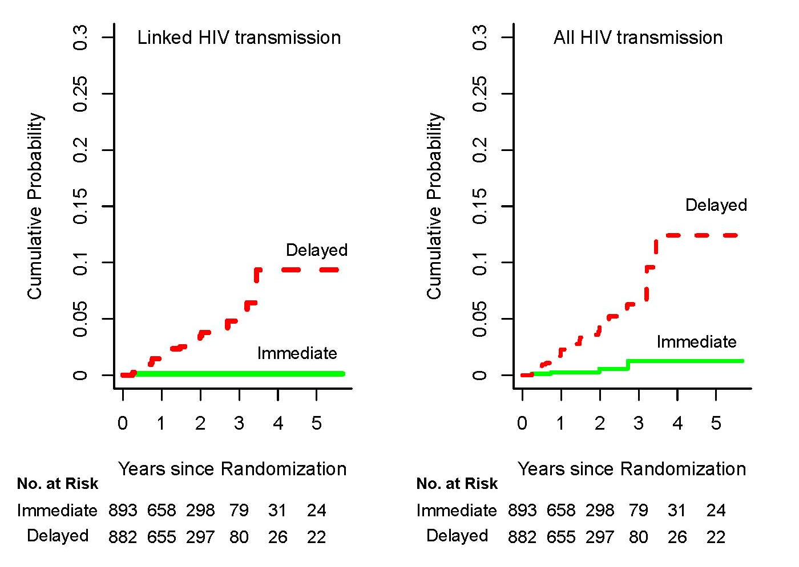
HPTN052: HIV-1 Transmissions
Notes:
Transmission events in thedelayed arm were distributed across all the years of he study.

Slide 104
Multivariate Analysis – Linked Transmission
Variable | Hazard Ratio | 95% Confidence Interval
Treatment (immediate vs. delayed) | 0.04 | [0.01 - 0.28]
Baseline CD4 (per 100 CD4 Increment) | 1.24 | [1.00 - 1.54]
Baseline VL (per unit log increment) | 2.84 | [1.51 - 5.41]
Baseline condom use (100% vs. <100%) | 0.33 | [0.12 - 0.91]
Gender (HIV +) (male vs. female) | 0.73 | [0.33 - 1.65]
Notes:
We performed multivariate cox proportional hazards regression and found the immediate treatment arm was associated with a 0038 (or 96% reduction). Additionally, reported 100% condom use was protective against linked transmission. Higher baseline CD4 and higher Viral load were associated with an increased risk of transmission. Gender was not a factor with respect to transmission but

Slide 105


HPTN 052 Prevention Conclusion
Early ART that suppresses viral replication led to 96% reduction of sexual transmission of HIV-1 in serodiscordant couples
THANK YOU!

Slide 106
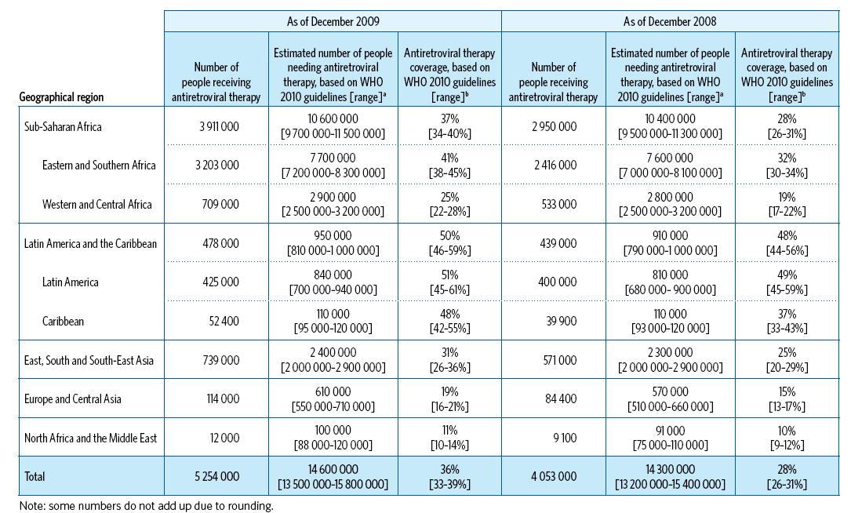
No.(all ages) on and needing ART, and % coverage,2008 to 2009

Slide 107
New HIV diagnoses (Adjusted) among MSM, UK, 2001-2010

Slide 108
New HIV diagnoses (Adjusted) among MSM, UK, 2001-2010
Despite 85% on ART and >95% of those undetectable

Slide 109
Problems
Cost-effective does not mean affordable
Many undiagnosed
Primary HIV infection drives a disproportionate amount of transmission

Slide 110
Summary:
HIV Prevention Research in 2011
Adapted from Padian et al. Lancet 2011

Slide 111


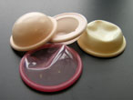



Management of genital infections (STIs)
Microbicides
Cervical Barriers
Male circumcision
HIV PREVENTION
Condoms
Behavioral Counseling and Testing
Chemoprophylaxis
MTCT
PEP
PrEP
ART
Vaccines
HSV-2 Suppressive therapy
Modified from Slim Karim 6th Transmission Workshop, 2011

Slide 112
Thank you
?
lwaters@nhs.net

Slide 113
Effectiveness of Prevention
HPTN-052
96%
Partners PrEP
73%
CDC TDF2
63%
Circumcision
54%
iPrEX
44%
STI
42%
CAPRISA
39%
RV144
31%
Abdool Karim & Abdool Karim. Lancet 2011

Slide 114
A Brief History of ART PrEP
1995
PMPA effective
in macaque
model
2006
HPTN-059
Phase 2
2011
Partners
PrEP
2011
Partners
PrEP
2012
MTN-003
VOICE
2010
iPrEX
2011
FEM-PrEP
2011
TDF2
2011
FACTS-001
2005
HPTN-050
Phase 1
2007
TDF
PrEP
Study
2010
CAPRISA 004
Phase 2B
2011
HPTN-052
Notes:
114
114

Slide 115
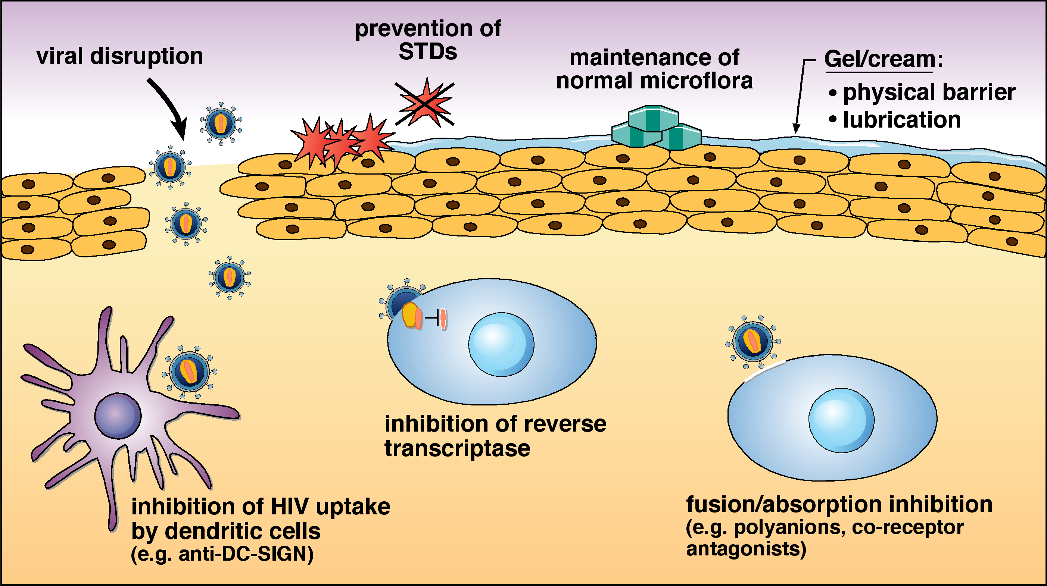
PrEP Mechanism of Action
McGowan I, Biologicals, 2006

Slide 116
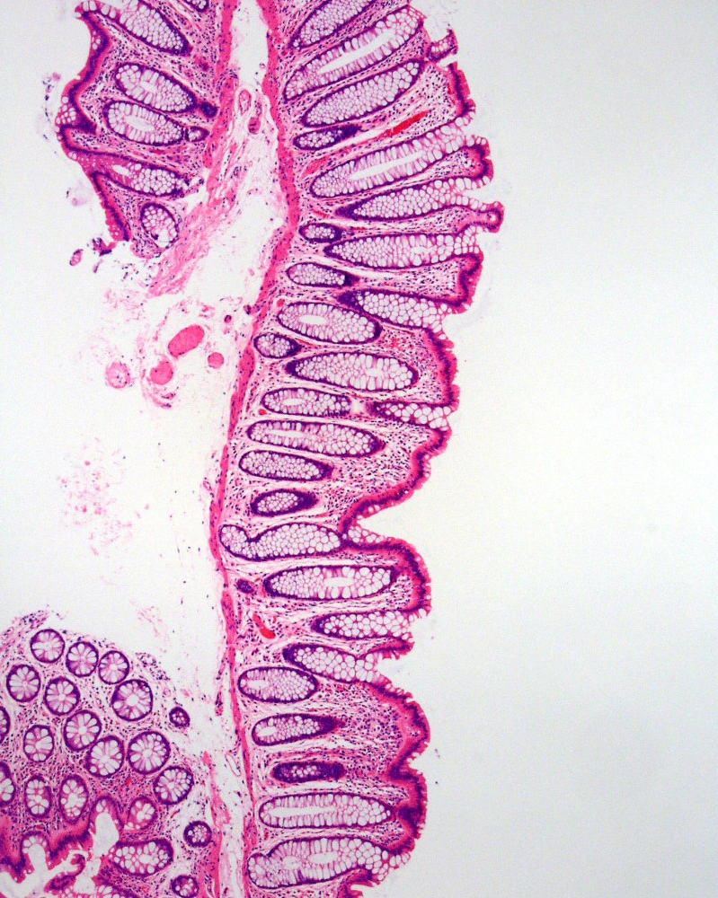
Compartmental PK
Blood
Mucosa
Oral
Topical
Concentration of ARV

Slide 117
MTN-001
Log₁₀ TFV & TFVpp (fmol/mg or pmol/mL*)
Tissue TFV
Tissue TFVpp
ECC TFVpp
CVL TFV
Serum TFV Cmax
PBMC TFVpp Cmax
Hendrix et al. CROI 2011
Notes:
This figure summarizes the relationships between TFV and TFVpp by route of dosing and clustered by anatomic location moving from blood to vaginal lumen. The units of measure are all in molar units to allow comparison of a the relative number of molecules regardless of site or phosphorylation. The y-axis is on a log₁₀ scale. As before, vaginal dosing is blue, oral green, and dual red.
First, note the 100-fold greater tissue and ECC concentration of active drug, TFVpp, after vaginal dosing when compared to oral dosing.
Second, note the equivalence of dual dosing to either oral or vaginal depending on site. Dual is always consistent with the highest of the other 2.
Other interesting findings also emerge.
Oral dosing achieves similar median concentrations in blood, tissue, and lumen; whereas, vaginal dosing achieves similar, 2 log higher concentrations in CVL and tissue, near concentrations of TFV in the gel, with a dramatic 3-4 log fall in blood concentration, also noted in PBMC.
TFVpp is typically 1.5-2 logs below the TFV concentration in the same compartment (blood, tissue).
Concentration gradient from tissue TFV to tissue TFVpp to ECC TFVpp consistent for all dosing regimens.
117

Slide 118
RMP-02 / MTN-006
Concentration of TVF-DP
(fmol/mg)
Route | Oral | Rectal (S) | Rectal (7D)
N Detectable | 7/18 | 10/12 | 12/12
Anton et al. CROI 2011

Slide 119
iPrEx Study
2,499 MSM and male-to-female transgendered women randomized to Truvada or placebo
44% reduction in HIV acquisition
Higher drug concentrations associated with increased protection
Grant et al. NEJM 2010

Slide 120
FEM-PrEP
1,951 women randomized to receive Truvada or placebo
Kenya, South Africa, and Tanzania
Study stopped because of futility
  56 HIV endpoints
    Truvada: N = 28
    Placebo: N = 28
Possible explanations for lack of efficacy
  Poor adherence or drug sharing
  Differential compartmental PK
  Chance
Notes:
Incidence 5% per year

Slide 121
Partners PrEP Study
4,758 HIV serodiscordant couples randomized to receive Viread, Truvada, or placebo
Kenya and Uganda
 | HIV EP | % | CI
Placebo | 47
Viread | 18 | 63 | 34-78
Truvada | 13 | 73 | 49-85
IAS 2011

Slide 122
CDC TDF2 Study
1,200 men and women randomized to Truvada or placebo
Botswana
 | HIV EP | % | CI
Placebo | 24
Truvada | 9 | 63 | 22-83
IAS 2011

Slide 123
CAPRISA 004
889 women randomized to receive tenofovir 1% gel or placebo with BAT regimen
South Africa
Protection significantly higher with concentrations of TNF in cervical fluid (> 1,000 ng/mL)
 | HIV EP | % | CI
Placebo | 60
Tenofovir | 38 | 39 | 6-60
Abdool Karim et al. Science 2010; Lancet 2011

Slide 124
MTN-003 (VOICE Study)
12,320
Screened
2,308 identified as HIV infected at Screening
4,983
Screened Out (not HIV+)
Uganda
322 Enrolled
South Africa
4,077 Enrolled
Zimbabwe
630 Enrolled
Total Enrollment = 5,029
Overall Screen to Enroll Ratio = 2.4:1
Notes:
124

Slide 125
Rectal Microbicides
Receptive anal sex common practice in MSM and heterosexuals
Proof of concept in NHP SIV/SHIV model
  Cyanovirin-N, tenofovir, MIV-150/carageenan
Phase 1 evaluation includes safety, acceptability, PK, and PD
  RMP-01 (UC781)
  RMP-02 / MTN-006 (tenofovir VF)
  MTN-007 (tenofovir RGVF)

Slide 126
RMP-02/MTN-006
Safety, PK / PD, acceptability
Single
rectal
tenofovir
(N = 18)
2:1
7 Day
Rectal
tenofovir
(N = 18)
2:1
Open label
Oral tenofovir
(N = 18)
Baseline
Evaluation
Anton et al. CROI 2011

Slide 127
PK/PD Relationship

Slide 128
Unanswered Questions
PrEP and ART resistance
  MTN-009 & MTN-015
Differential safety and efficacy between oral and topical PrEP
  VOICE study
Use of topical PrEP in adolescents
  MTN-021
Use of PREP in pregnancy
  MTN-002, MTN-016, and MTN-019

